Slide 1

BRITISH AIRWAYS
Customer Feedback Analysis and Insights
20/11/2024

Slide 2
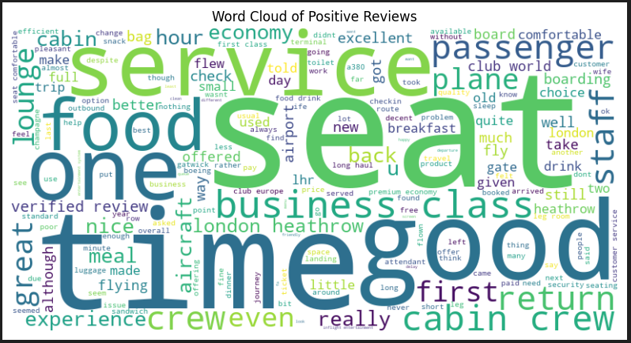
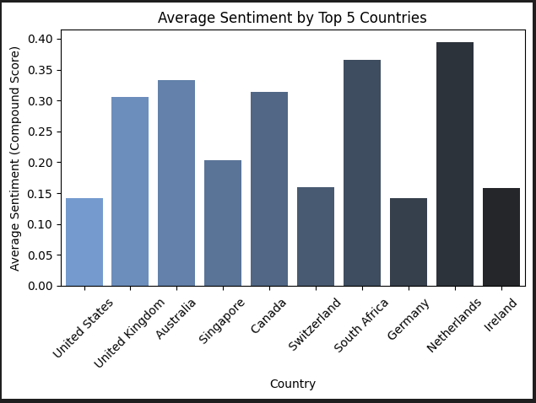


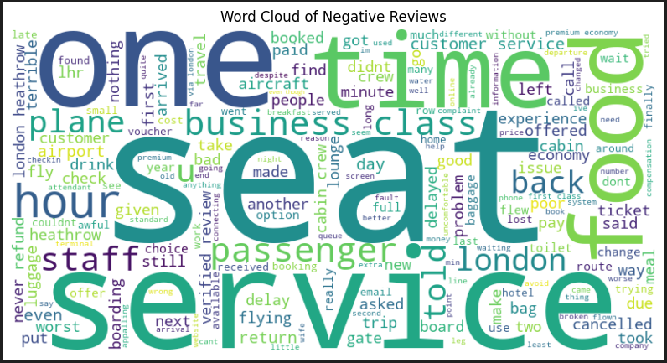
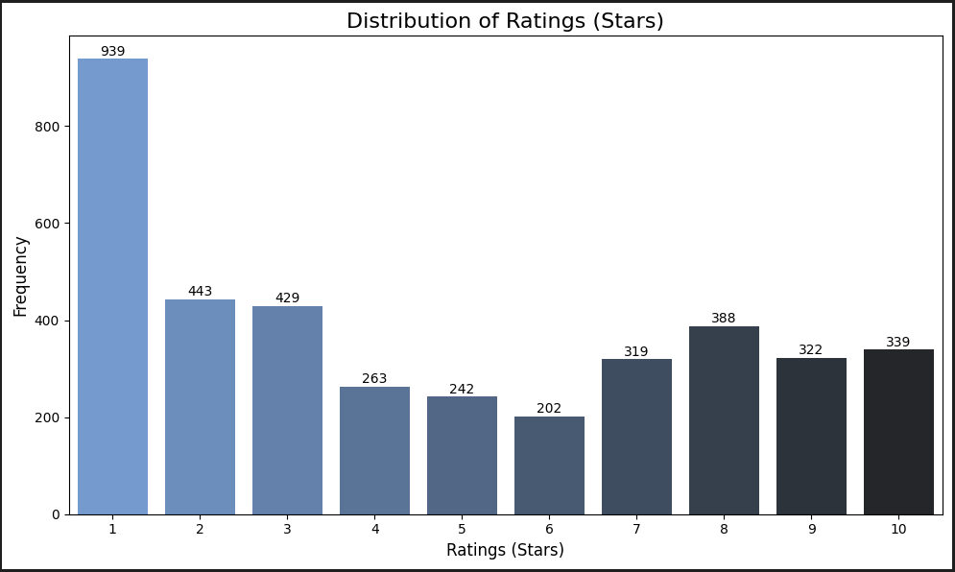
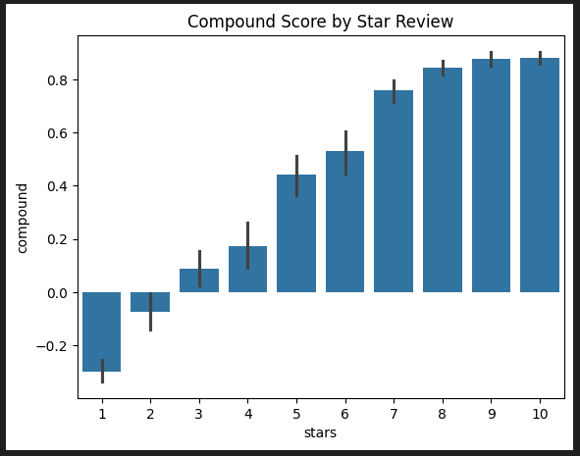
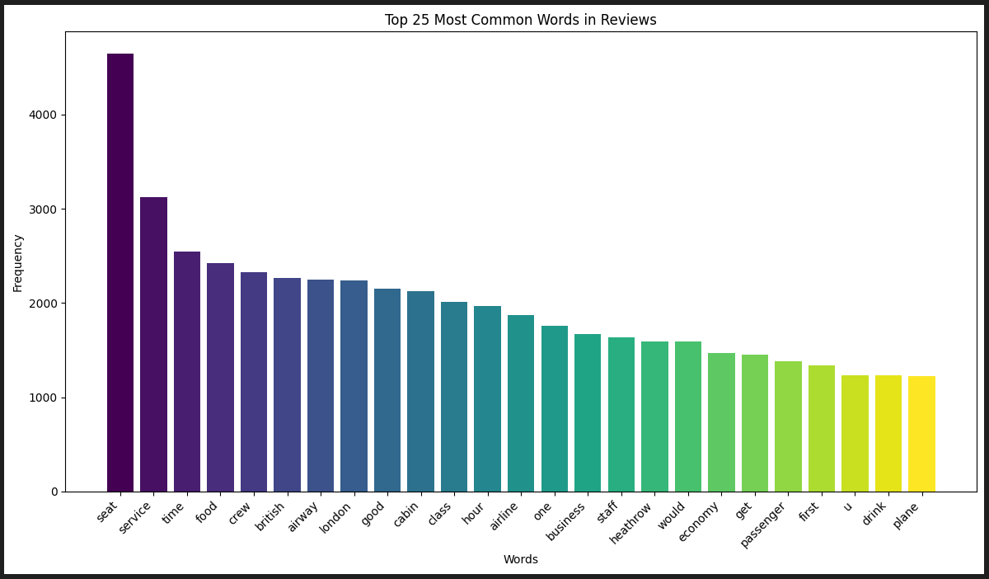
Customer Feedback Analysis: Key Insights
Average Star Rating
4.68/10
Total reviews
3894
Customer Sentiment Score
0.29
With a Sentiment score of 0.29 and an average star rating of 4.68/10, customer feedback reflects mixed experiences. While higher star ratings correlate with positive sentiment, the prevalence of low ratings indicates dissatisfaction with key services, especially in Economy Class.
Countries like the Netherlands and South Africa have the most positive sentiments, while the U.S. shows more neutral feedback. Additionally, sentiment scores correlate strongly with star ratings, with lower ratings showing dissatisfaction and higher ratings indicating positive experiences.
Positive reviews emphasize time, seat, and service, reflecting satisfaction with comfort and efficiency. Negative reviews focus on delays and service, highlighting issues to address. The most common words reveal customer priorities like crew, cabin, and food, offering areas to improve and sustain quality.
Customers Appreciate premium experiences like attentive cabin crew, comfortable seating, and efficient service, especially in Business and First Class. Focus should be placed on addressing delays, cancellations, and communication issues in Economy Class. Improving consistency and enhancing service quality across all classes can drive higher satisfaction and loyalty.

